Slide 1
F.Hosseinpanah

Slide 2
What is the rational behind Risk stratification
To select patients who are candidate for CAD screening
To determine goal of BP treatment
To determine goal of dyslipidemia treatment

Slide 4
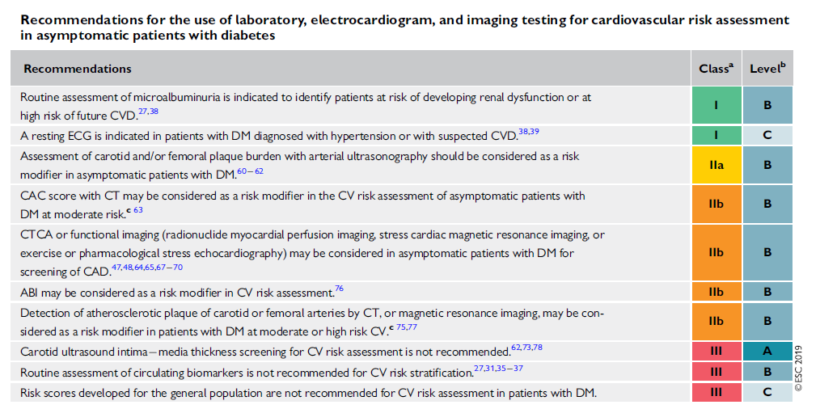

Slide 8
ADA 2020

Slide 10
Clinical Scenario
A 50 year old male comes to see you for diabetes review. He has had type 2 diabetes for 5 years and hypertension for 2 years. He is also smoker (20 packs/year). There is no report of typical or atypical cardiovascular symptoms.
He is taking MFN 2g /daily , Sitagliptin 100 mg/daily, Atorvastatin 20 mg /daily, Captopril 50 mg/daily,
BMI = 31 Kg/m²
BP= 135/80 mmHg

Slide 11
Clinical Scenario…
HbA1c 7.8 %, eGFR= 65 ml/min/1.73 m², TG= 210 mg/dl, HDL=38 mg/dl, LDL= 65 mg/dl
24 uriary albumin excretion= 75 mg
^{No retinopathy was detected}

Slide 12
What is the rational behind Risk stratification
To select patients who are candidate for CAD screening
To determine goal of BP treatment
To determine goal of dyslipidemia treatment

Slide 18
ADA 2020

Slide 20
Sodium-glucose co-transporter-2 inhibitors and heart failure

Slide 21
Aim : To define the cardiovascular benefits and the effects on key safety outcomes of SGLT2 inhibition, overall and separately among participants with and without established CVD, reduced kidney function, or HF
J Am Heart Assoc. 2020;9:e014908. DOI: 10.1161/JAHA.119.014908.

Slide 26
Glucagon-like peptide-1 agonists and heart failure

Slide 27
Dipeptidyl peptidase-4 inhibitors and heart failure

Slide 29
ADA 2020

Slide 30
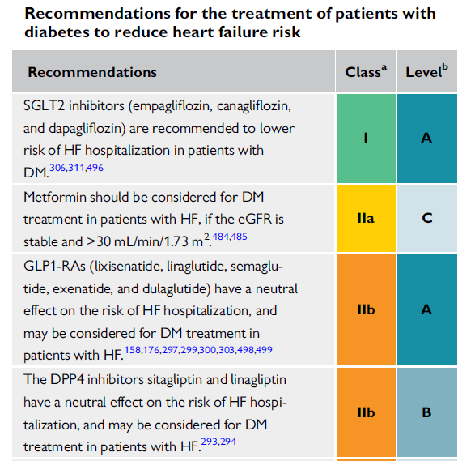
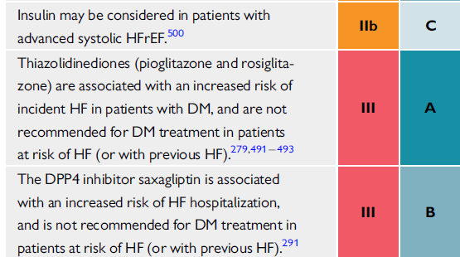

Slide 31
Do SGLT-2 inhibitors reduce morbidity and mortality in HFpEF?
DELIVER (Dapagliflozin Evaluation to Improve the Lives of Patients With Preserved Ejection Fraction Heart Failure) [NCT03619213]
EMPEROR-Preserved (Empagliflozin Outcome Trial in Patients With Chronic Heart Failure With Preserved Ejection Fraction) [NCT03057951]

Slide 32
An important Unanswered Question
What is the optimal method to identify patients with type 2 DM at highest risk for developing HF?

Slide 33
Aim: To develop and validate a practical clinical risk score for HHF in patients with T2DM and assess whether this score can identify high-risk patients with T2DM who have the greatest reduction in risk for HHF with a SGLT2 inhibitor
A clinical risk score for HHF in 8212 patients with T2DM in the placebo arm of SAVOR-TIMI 53 was developed
The score was validated in 8578 patients with T2DM in the placebo arm of DECLARE-TIMI 58
The Relative and absolute risk reductions in HHF with SGLT-2 inhibitor dapagliflozin were assessed by baseline HHF risk.
Circulation. 2019;140:1569–1577

Slide 34
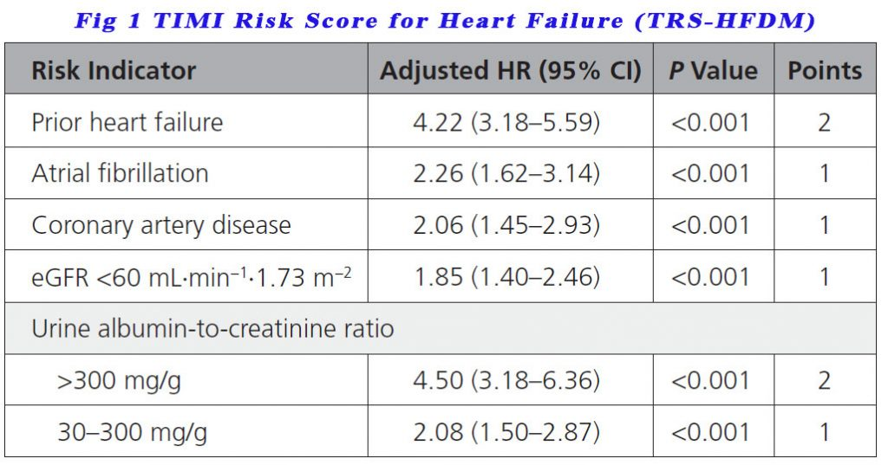
Patients scoring 0 points were low risk of developing HF, those with 1 point were in intermediate risk, those with 2 points were high risk while those with 3 points or more were classed as very high risk.

Slide 37
Impact of glucose-lowering drugs on heart failure

